Slide 1

BUS TRACKING SYSTEM USING GPS
FINAL PROJECT

Slide 2

Department of Computer Science and Engineering
Project presentation on
COLLEGE BUS TRACKING SYSTEM USING GPS
Presented By:
Ali Rafeek Abboud (19BTRSE052)
Bisher Ali Merhge (19BTRSE056)
Guided by: Dr.S.Anthoniraj
Nure Jannati Rahman (19BTRSE067 )

Slide 3

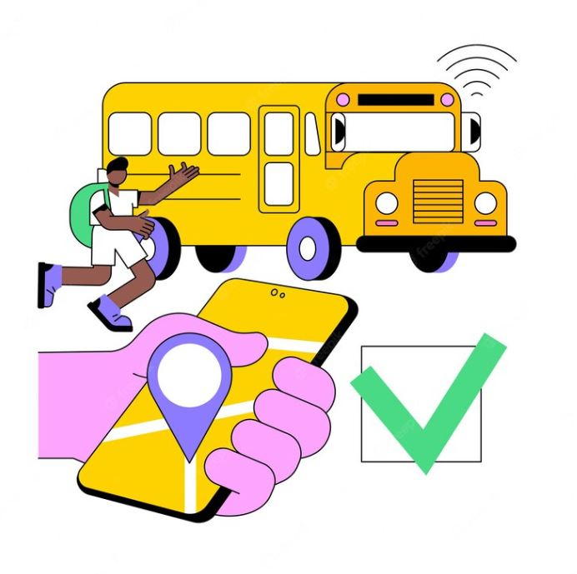
Contents
Abstract
Introduction
Literature Survey
Existing and Proposed system with Limitations
Problem Statement
Objective
System Architecture
System Requirements (Hardware & Software)
Result
Conclusion and Future Scope
References

Slide 4
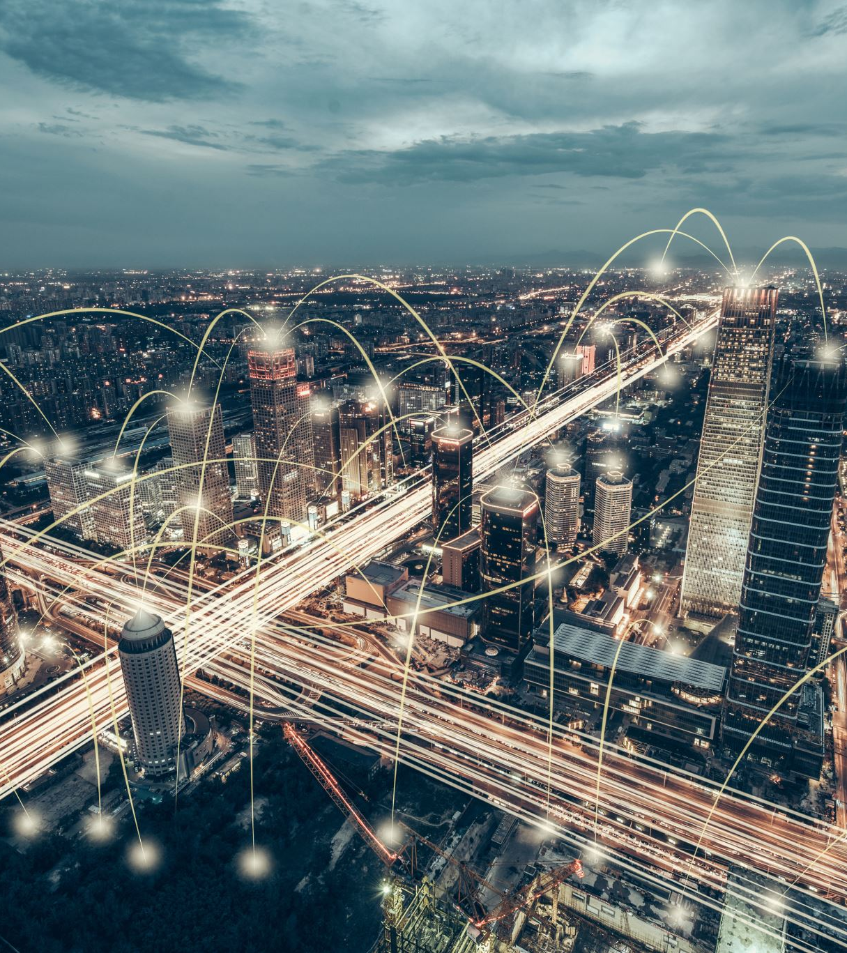
Abstract
The present generation requires the information time to time.The use of technogology have been increasing day by day.So we are planning for the combination of present technology with the requirement of information transmission, we planned for the creative approach of “Vehicle Tracking System using GPS and GSM”.

Slide 5
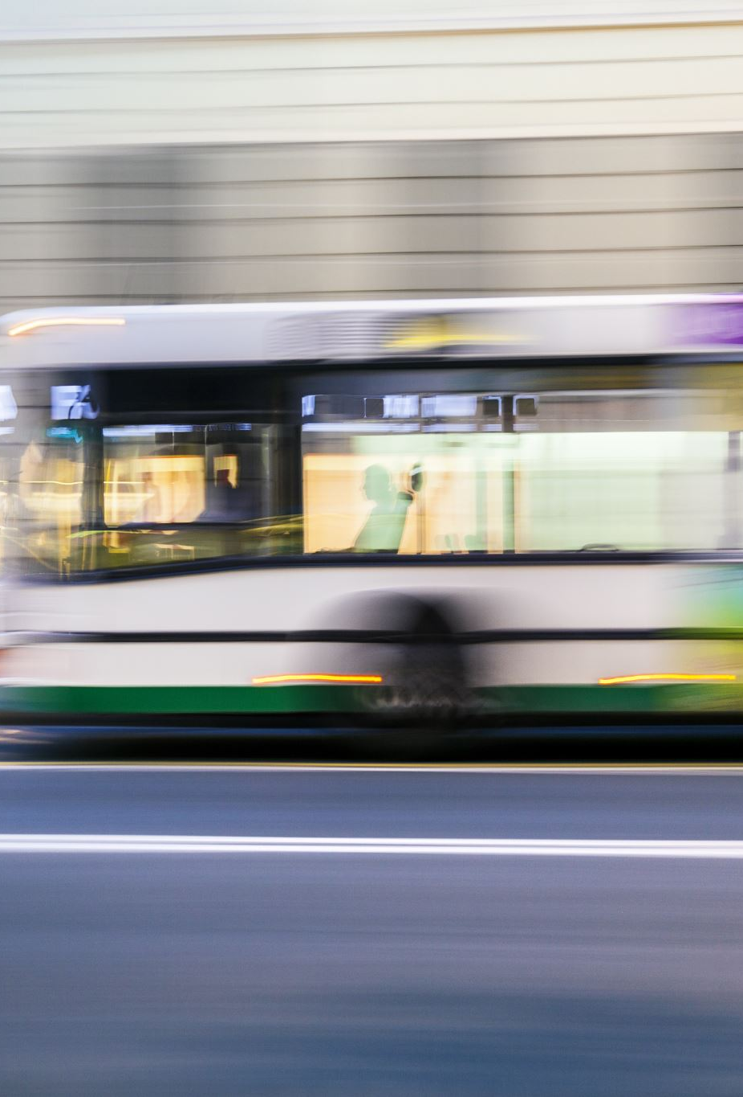
Introduction
The use of GPS technology has revolutionized the way we navigate and travel. With the advent of GPS tracking systems, it is now possible to track the location of vehicles in real-time. This technology has been particularly useful in the transportation industry, where buses can be tracked to provide accurate arrival times and improve overall efficiency.
In this presentation, we will explore the benefits of a bus tracking system using GPS technology. We will examine how it works, its advantages, and its potential impact on the transportation industry.

Slide 6

Literature Survey
Recently, all over the world, crime against children is increasing at higher rates and it is high time to offer safety support system for the children going to schools. This paper focuses on implementing children tracking system for every child attending school. However the existing systems are not powerful enough to prevent the crime against children since these systems give information about the children group and not about each child resulting in low assurance about their child safety to parents and also does not concentrate on sensing the cry of the child and intimating the same to its parents. The proposed system includes a child module and two receiver modules for getting the information about the missed child on periodical basis. The child module includes ARM7 microcontroller (lpc 2378), Global positioning system (GPS), Global system for mobile communication (GSM), Voice playback circuit and the receiver module includes Android mobile device in parent’s hand and the other as monitoring database in control room of the school. Finally, implementation results for the proposed system are provided in this paper

Slide 7
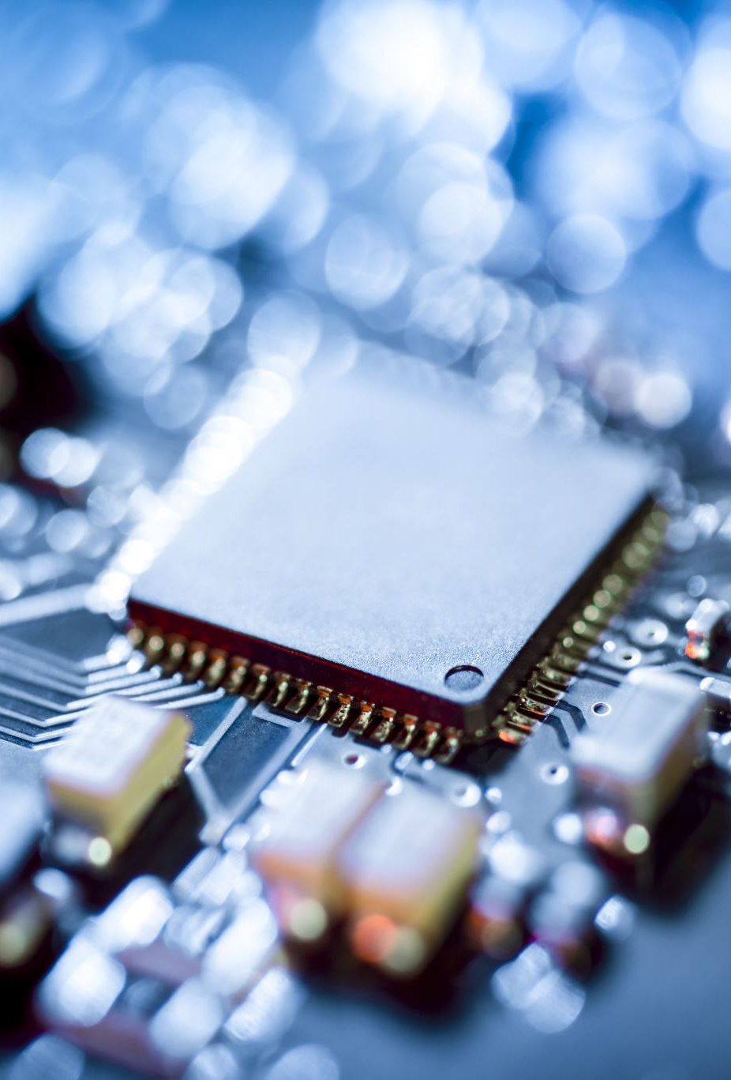
Existing and Proposed system with Limitations
The existing system has many disadvantages related to cost, performance etc. The proposed system is going to reduce all the defects of existing system. The proposed system uses the Arduino Uno kit which provides power of microcontroller as well as microprocessor which is going to increase the performance of the system with less energy consumption

Slide 8

Problem Statement
The objective of this proposed system is to develop an application which will help to provide security for school going children’s. This allows parents and management to check the status of secure smart school bus by using Iota. The proposed system will provide various facilities like speed control, check drunk and drive, missing children’s, accident emergencies, inappropriate drop, panic button, logistic management etc. which are helpful for child security.

Slide 9
Objectives
College bus Tracking System (VTS) is the technology used to determine the location of a vehicle using different methods like GPS and other radio navigation systems operating through satellites and ground based stations. By following triangulation or trilateration methods the tracking system enables to calculate easy and accurate location of the vehicle.
Vehicle information like location details, speed, distance traveled etc. can be viewed on a digital mapping with the help of a software via Internet. Even data can be stored and downloaded to a computer from the GPS unit at a base station and that can later be used for analysis.
This system is an important tool for tracking each vehicle at a given period of time and now it is becoming increasingly popular for people having expensive cars and hence as a theft prevention and retrieval device.

Slide 10
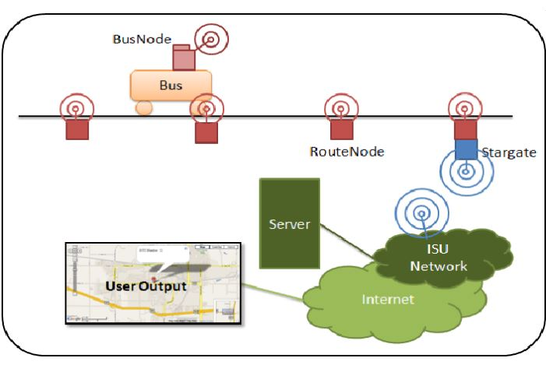
System Architecture

Slide 11
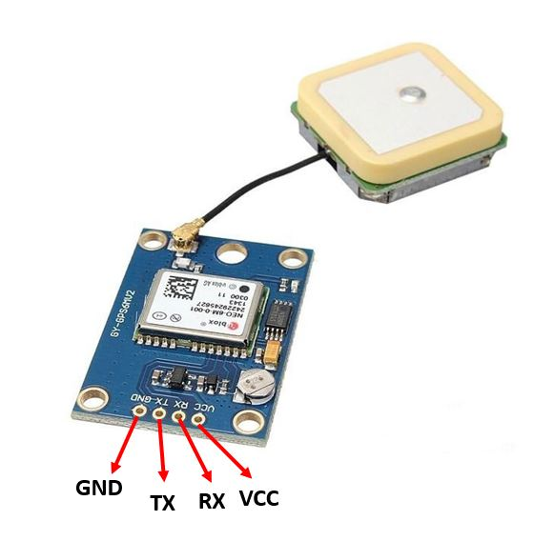
System Hardware Components: NEO6M GPS Module
The NEO-6M GPS module is a popular GPS receiver with a built-in ceramic antenna, which provides a strong satellite search capability. This receiver has the ability to sense locations by tracking up to 22 satellites and identifies locations anywhere in the world. With the on-board signal indicator, we can monitor the network status of the module. It has a data backup battery so that the module can save the data when the main power is shut down accidentally.
The core heart inside the GPS receiver module is the NEO-6M GPS chip from u-blox. It can track up to 22 satellites on 50 channels and have a very impressive sensitivity level which is -161 dBm. This 50-channel u-blox 6 positioning engine boasts a Time-To-First-Fix (TTFF) of under 1 second. This module supports the baud rate from 4800-230400 bps and has the default baud of 9600.

Slide 12
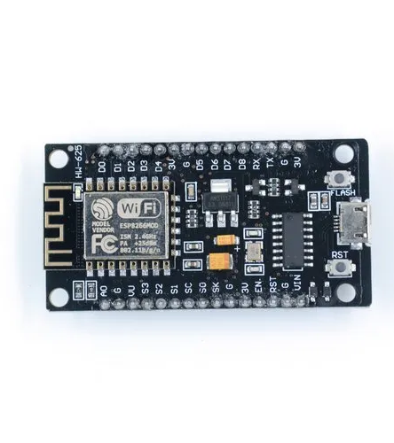
ESP8266 NodeMCU:
NodeMCU is an open-source firmware and development kit that helps you to prototype or build IoT products. It includes firmware that runs on the ESP8266 Wi-Fi SoC from Espressif Systems, and hardware which is based on the ESP-12 module. The firmware uses the Lua scripting language..

Slide 13
System Software Components:
Arduino IDE :
Arduino is a prototype platform (open-source) based on an easy-to-use hardware and software. It consists of a circuit board, which can be programed (referred to as a microcontroller) and a ready-made software called Arduino IDE (Integrated Development Environment), which is used to write and upload the computer code to the physical board.
Embedded C :
Embedded C is one of the most popular and most commonly used Programming Languages in the development of Embedded Systems.

Slide 14
CONCLUSION
The proposed system will provide various facilities like check drunk and drive, children’s entry and exit information, accident emergencies, inappropriate drop, GPS tracking system, logistic management etc., which are helpful for child security.
The various advantages of the proposed system are Transportation Safety, Student Safety and Attendance of ward is a time benefit for school management.

Slide 15
FUTURE SCOPE
Many cities have found that GPS tracking system not only improve the efficiency of city bus operation, but also encourage commuters to take the advantage of city bus system.
Many city bus system have discovered that GPS tracking system which allows to monitor the location and arrival time of their bus actually increase the number of people using city buses for routine communing.

Slide 16

References
[1]. Chen, H., Chiang, Y. Chang, F., H. Wang, H. (2010). Toward Real-Time Precise Point Positioning: Differential GPS Based on IGS Ultra Rapid Product,SICE Annual Conference, The Grand Hotel, Taipei, Taiwan August 18-21.
[2]. Asaad M. J. Al-Hindawi, Ibraheem Talib, “Experimentally Evaluation of GPS/GSM Based System Design”, Journal of Electronic Systems Volume 2 Number 2 June 2012 [3]. Chen Peijiang, Jiang Xuehua, “Design and Implementation of Remote monitoring system based on GSM,” vol.42, pp.167-175. 2008.
[4]. V.Ramya, B. Palaniappan, K. Karthick, “Embedded Controller for Vehicle In-Front Obstacle Detection and Cabin Safety Alert System”, International Journal of
Computer Science & Information Technology (IJCSIT) Vol 4, No 2, April 2012. [5]. www.8051projects.com
[6]. www.wikipedia.org.com
[7]. www.atmel.com
[8]. www.tatateleservices.com
[9]. www.roseindia.net
[10]. www.electronicsforyou.com

Slide 17


